Slide 1
ICT & Software Engineering
04 – Windows Forms APP
Lists, Comboboxes & Tab Control

Slide 2

Content
Topics of this lecture
Controls for Images, Booleans & Collections
Controls for Timer & Layout

Slide 3
Windows forms App
Advanced controls

Slide 4


Controls: CheckBox and RadioButton
To select and choose between options
Radiobuttons are exclusive, checkboxes are not
Both have a .Checked property that indicates if they are selected by a Boolean value. (e.g. rbnDrink.Checked or cbAge.Checked)

Slide 5

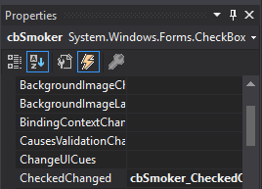

‘Syntax’
CheckBox
Event for un-/checking the Control
private void cbSmoker_CheckedChanged(object sender, EventArgs e)
{
if(cbSmoker.Checked)
{
<statements>
}
}

Slide 6

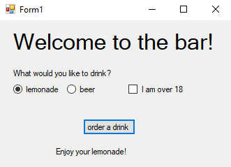
Your turn (15 minutes)!
Create an app to contain a choice of drinks (by RadioButton) and a CheckBox to indicate if the user is old enough to order beer.
Show a message for each possible situation

Slide 7

Questions?

Slide 8
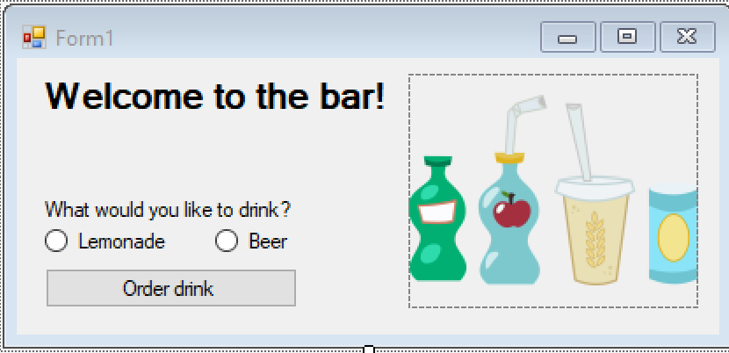
Enriching the GUI with images

Slide 9
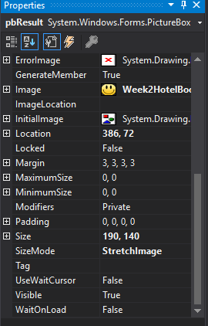

‘Syntax’
PictureBox
The selected picture
PictureBox in the form
Select how the picture is shown

Slide 10

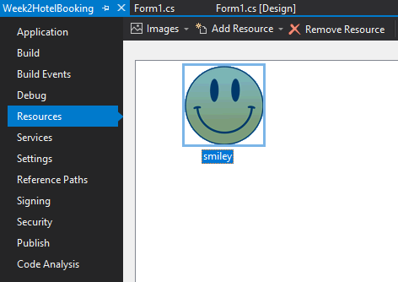
‘Syntax’: Adding resources
Pictures can be added as resources to a project
Right-click on Project Name -> Properties -> Resources
Add existing resources here

Slide 11
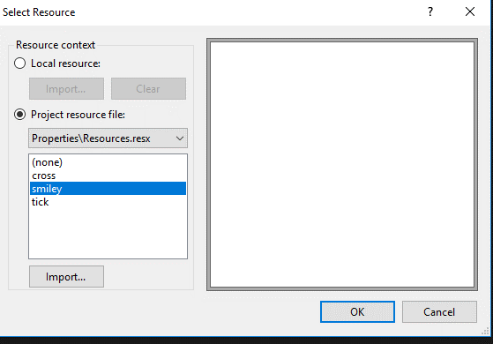
Extra information (cont.)
Select the image displayed in the PictureBox
Select PictureBox -> Properties -> Image
Select PictureBox -> Properties -> SizeMode to change the scaling of the picture
See existing resources

Slide 12
Demo
Swapping images based on drinks

Slide 13
Questions?

Slide 14
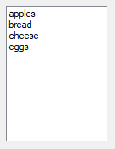

Representing a collection of data
ListBox & ComboBox

Slide 15

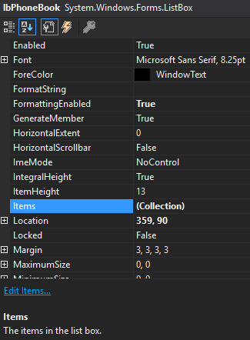
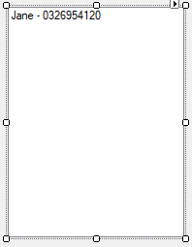
‘Syntax’
Properties of ListBox
The ListBox displays each element in Items

Slide 16
‘Syntax’ (cont.)
You can also add an element to Items programmatically
You can remove all items from the ListBox
lbPhoneBook.Items.Add("Emily - 065884513");
lbPhoneBook.Items.Clear();

Slide 17
Intro: ComboBox
What would be needed to display multiple options for a user to select?
Listbox
ComboBox

Slide 18
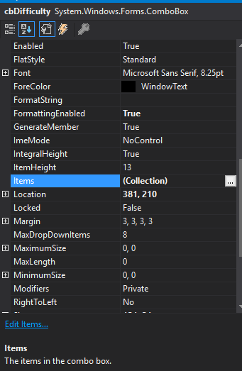
ComboBox
Properties of ComboBox
The set of elements shown in the ComboBox

Slide 19
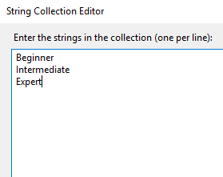
ComboBox (cont.)
Setting the options: click on the 3 dots (…) after (Collection)
The options to be displayed
The ComboBox

Slide 20
ComboBox (cont.)
A ComboBox can be seen as a combination of a TextBox and a ListBox
There are multiple ways to get the value:
cmbLevel.Text
cmbLevel.SelectedItem
These are not equivalent! What would be the difference?
cmbLevel

Slide 21
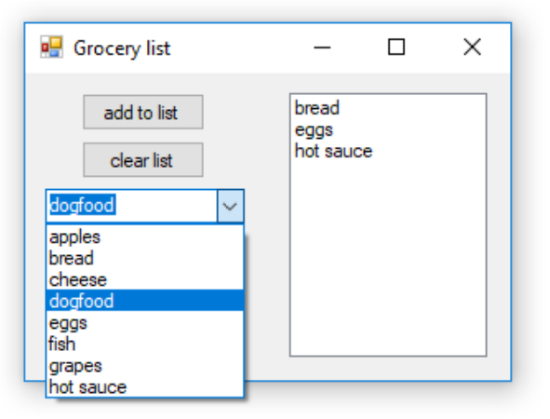
Demo
Write an app to add items to a grocery list.
Use a ComboBox for input
Display the grocery list in a ListBox

Slide 22
Questions?

Slide 23
Your turn (15 minutes)!
Extend the application with a collection of drinks
Make sure you still show a message for dinks with alcohol

Slide 24
Part 2 - Practical
See canvas for practical assignments

Slide 25
Content
Topics of this lecture
Controls for Images, Booleans & Collections
Controls for Timer & Layout

Slide 26
Questions about practical?

Slide 27
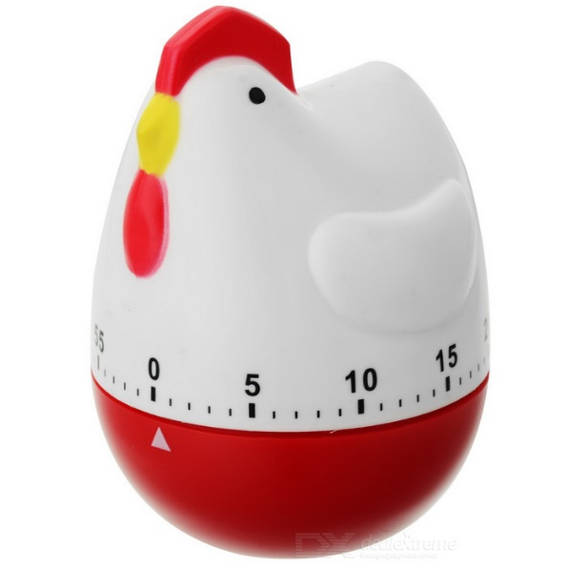
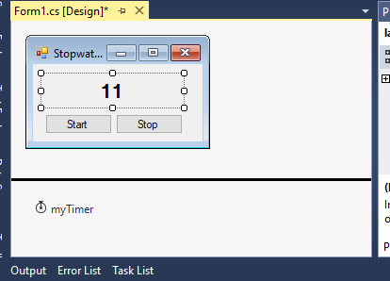
Intro: Timer
What would be needed to program some functionality that happens at set intervals. For example, every second?
There is a control called Timer
Not displayed in the actual GUI

Slide 28
Syntax
Some properties and the Tick-event-handler
timer1.Interval = 1000; // amount in milliseconds
timer1.Enabled = true;
timer1.Start(); //same effect as the former statement
timer1.Stop(); //same effect as timer1.Enabled = false;
//Tick event – occurs every timer1.Interval milliseconds (1 second here)
private void timer1_Tick(object sender, EventArgs e)
{
<statements>
}

Slide 29

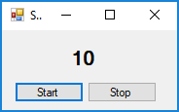
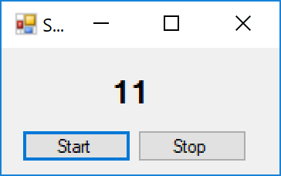
Demo
Create an application mimicking a stopwatch showing how many seconds have passed
<after 1 second has passed>

Slide 30
GUI Design
For a better user experience

Slide 31
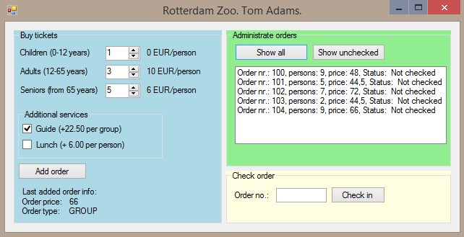
Up until now: one form with controls

Slide 32
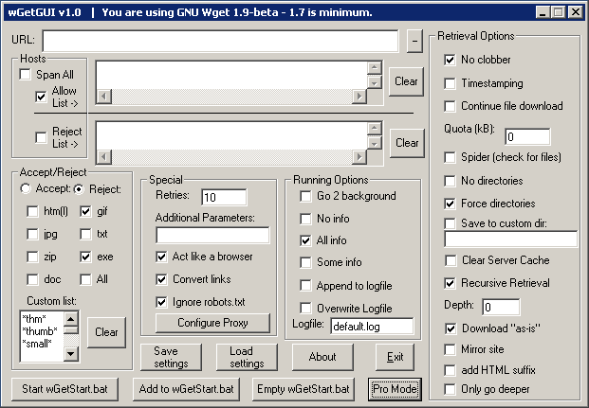
Up until now: one form with controls
How would you redesign this GUI?

Slide 33
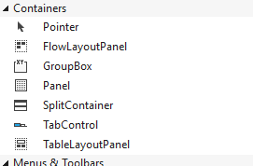
Intro: Tab Control
Windows Form Application have container controls

Slide 34
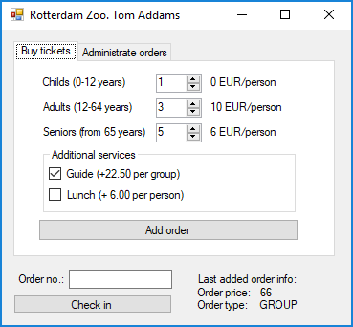
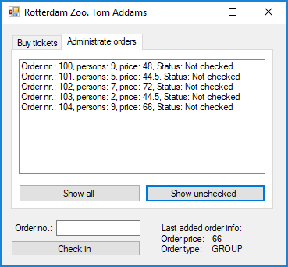
Intro: TabControl

Slide 35
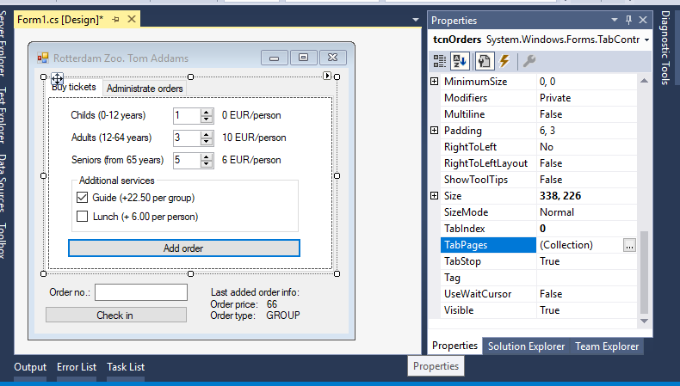
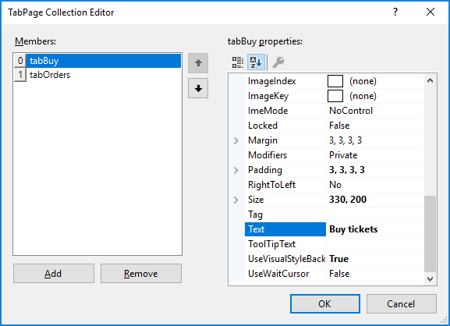
Examples

Slide 36
Syntax
Some useful properties of a TabControl:
tabControl.SelectedIndex = 1; // Gets or sets active TabPage via its index
tabControl.SelectTab(1); // Sets active TabPage via its index
tabControl.SelectTab("tabPageName"); // Sets active TabPage via its name
//Selected index changed event occurs every time a new tab is clicked
private void tabControl_SelectedIndexChanged(object sender, EventArgs e)
{
<statements>
}

Slide 37

Summary
After this lecture you can:
Display and retrieve information using Controls
Store and manipulate that information using variables
Trigger code at set time intervals
Style your form with TabControls

